Slide 1
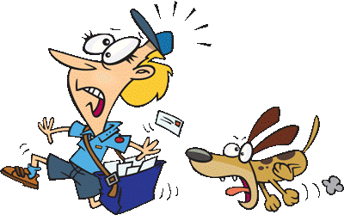

Slide 2
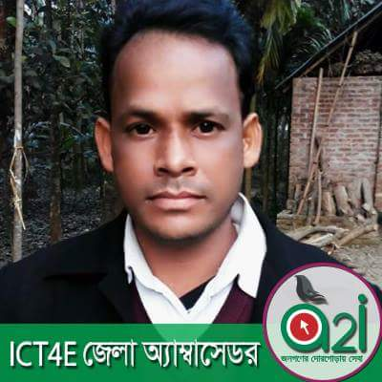
Introduction
Md. Ashraful Islam Prodhan
Assistant Teacher (English)
Khuksia Dakhil Madrasha
Gobindagonj , Gaibandha.
Email: ashrafulis1984@gmail.com
Mobile: 01744667140
English 2nd Paper
Class – Seven
Time – 50 Minute

Slide 3
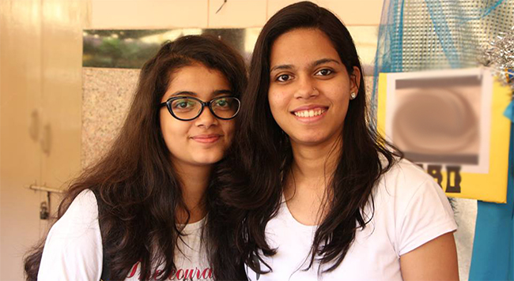
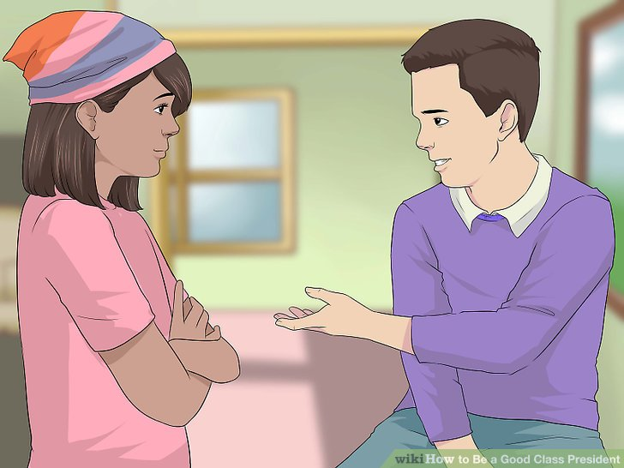
Look at the sentences and pictures:
Tania and Tanjia are friends.
Tanjim is a boy but Sanjida is a girl.

Slide 4
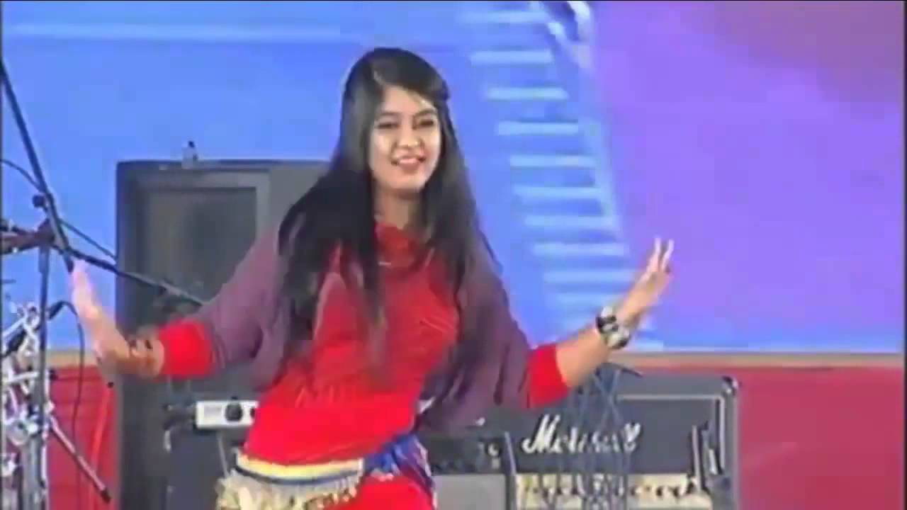
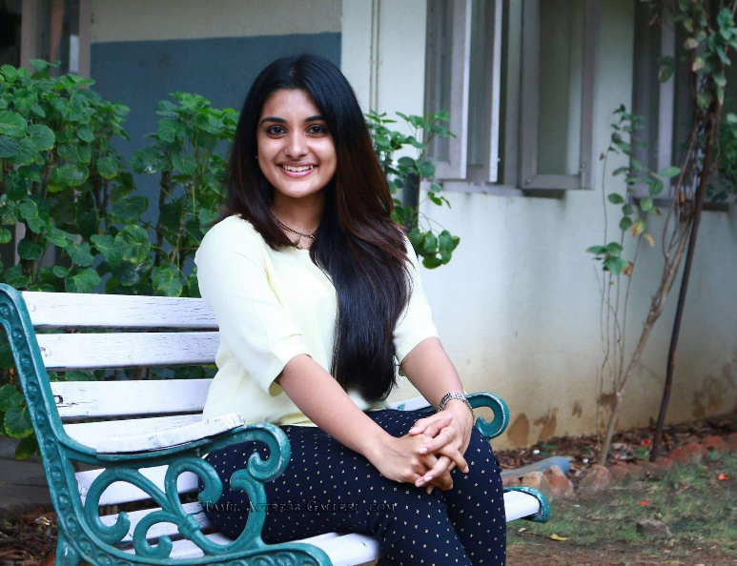
She both sings and dance.
Wait here till I return.
What do the underlines say ?
Conjunction

Slide 5
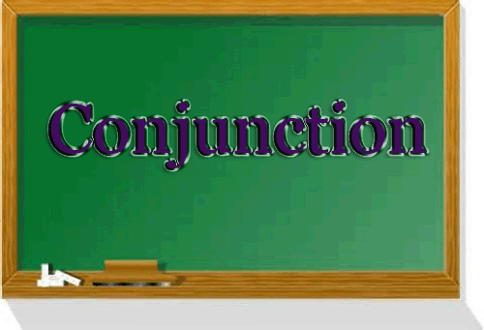
Our today’s topic is-

Slide 6
Learning Outcomes
At the end of the lesson, we will be able to—
Define conjunctions.
Say the features and kind of conjunctions.
Identify the conjunctions in given sentence.
Proper use of conjunctions.

Slide 7
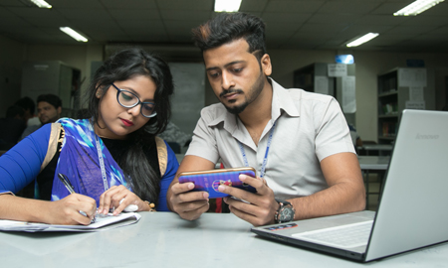
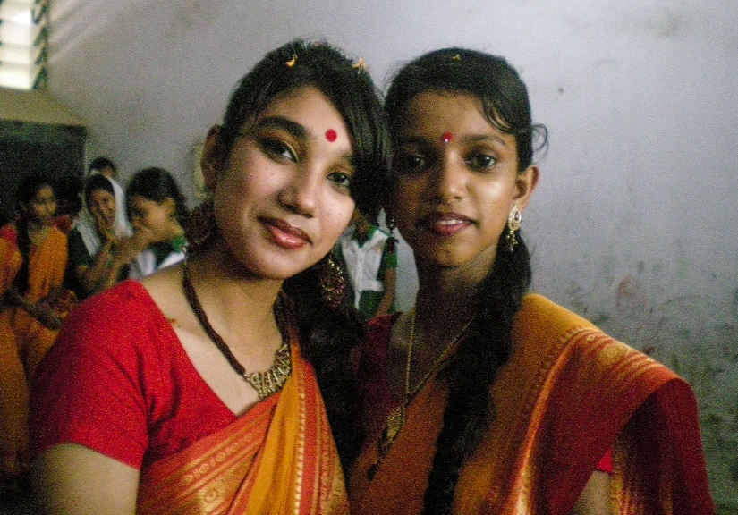
Definition of Conjunction:
Definition of conjunction:
A conjunction is a word used to join words, phrases and sentences.
Tamanna and I are in the same class.
Samia and Fahmida are sisters.

Slide 8
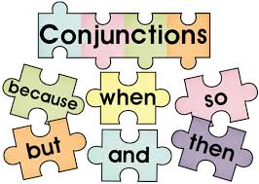
Classification of Conjunction:
Conjunction are mainly three type. Such as:
Coordinating conjunction
Subordinating conjunction
Compound conjunction

Slide 9
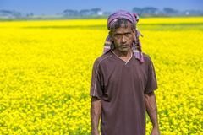
1. Coordinating conjunction:
The word that joins two words or sentence parts of equal importance is called a coordinating conjunction.
He is pious and truthful.
The man is poor but honest.

Slide 10
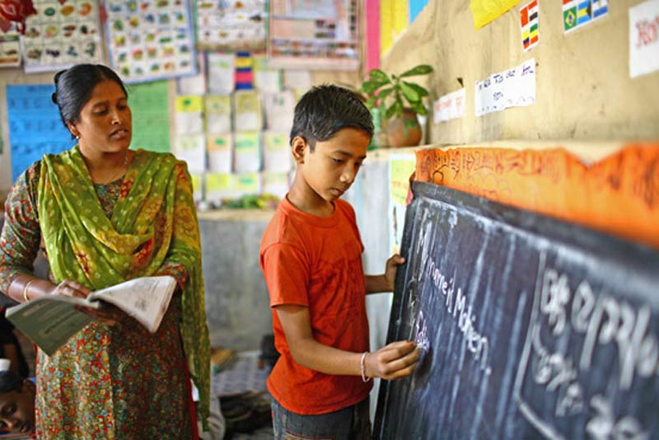
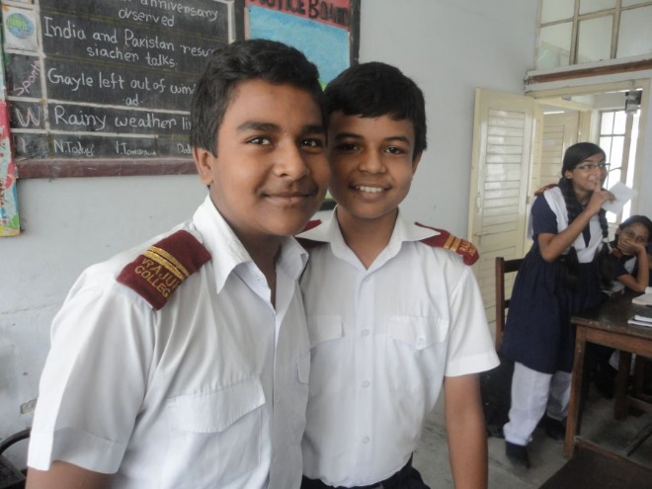
2. Subordinating Conjunction:
The word that introduces a subordinate clause and adds information to the main clause is called a subordinating conjunction.
He did as I told him.
He is older than I.

Slide 11
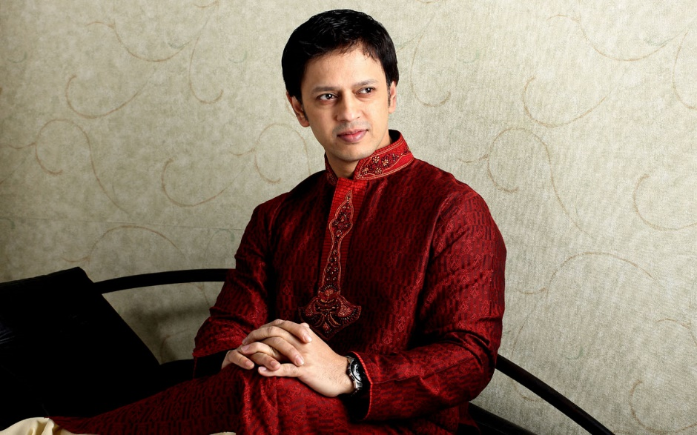
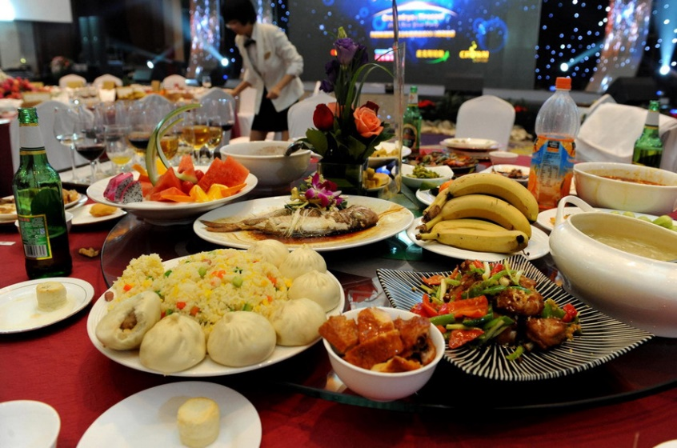
3. Compound Conjunction:
A compound conjunction is one that consists of more than one word.
He looks as if he were rich.
We eat food so that we can keep alive.

Slide 12
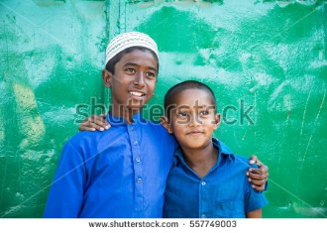
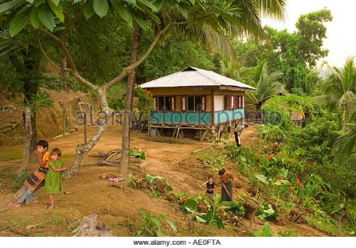
Read the following passage and notice the words in bold:
Dipu and Raj are good friends but they are not of the same age. They have been even together as neighbors. Many years back they thought they would settle abroad but after their higher study overseas they decided to buy land in the same area. When they found it together, Raj said to Dipu, ”Let’s buy it now or never.” They have not constructed any building yet.
Here - The words and, but, or, because, yet are called conjunctions. The main functions of these words is to link words, phrases and clauses together.

Slide 13
Individual work
Identify conjunctions in the following passage:
Nazma and Diba are good friends. The former is tall but the letter is short. One day they were walking home from school. They were not in a hurry, yet they were walking very fast. Suddenly, Nazma’s knee started hurting so she stopped walking. Diba also stopped and asked her what had happened. Nazma said that she could not walk because her left knee was hurting.

Slide 14
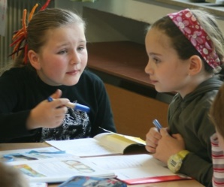
Pair work
Fill in the gaps with right conjunctions:
He writes slowly ----- neatly.
Water ---- oil will not mix.
He is poor ----- honest.
They went to market ---- bought cosmetics.
Try hard ----- you will fail.
We played ---- won the game.
He is rich ----- dishonest.

Slide 15
Group work
Write few sentences on ‘Your English Teacher’ using as many conjunctions as possible.

Slide 16
Evaluation
Fill in the gaps with conjunctions:
The man is poor --- honest.
He is pious --- truthful.
Wait here --- I return.
Answer key: (1) but , (2) and , (3) till .

Slide 17
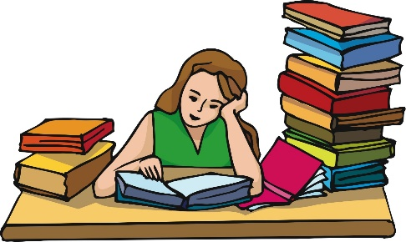
Write the following questions and answer them:
What is conjunctions?
How many types of conjunctions ?

Slide 18
